Slide 1


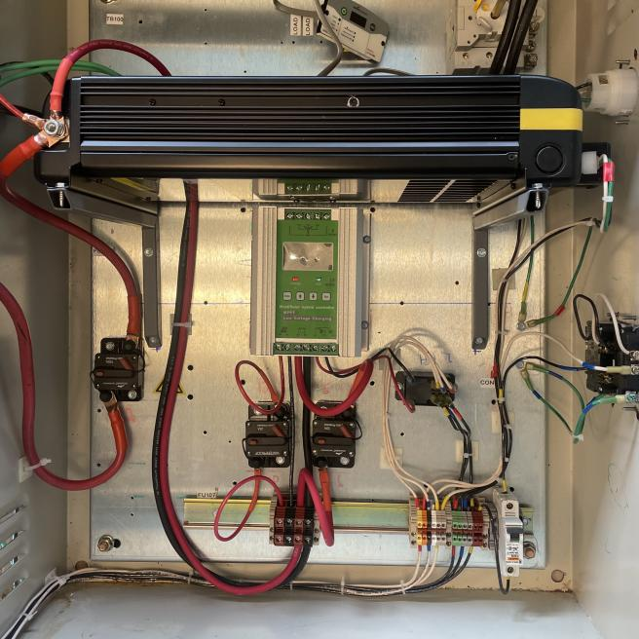
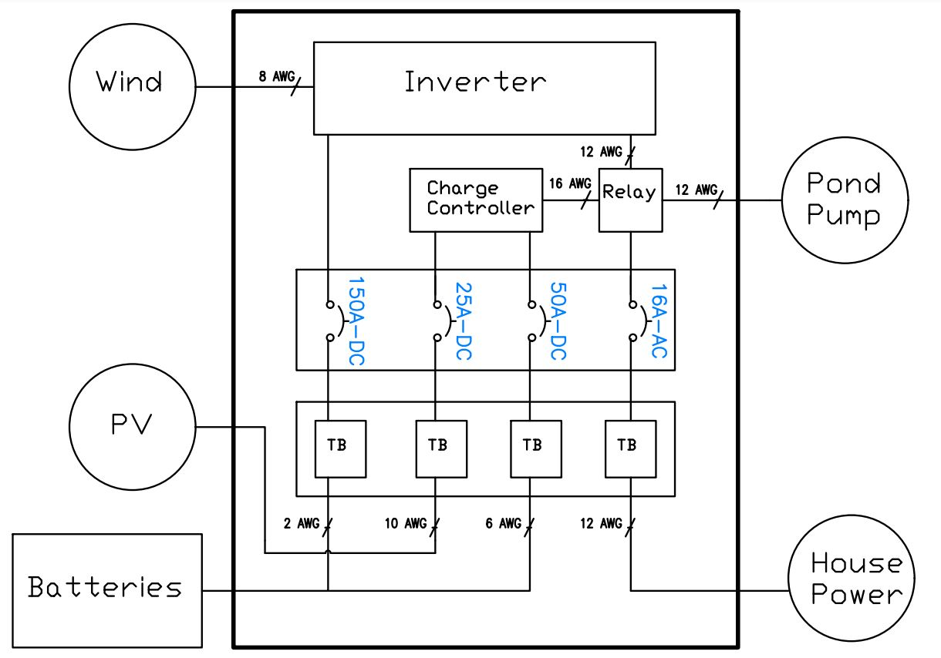

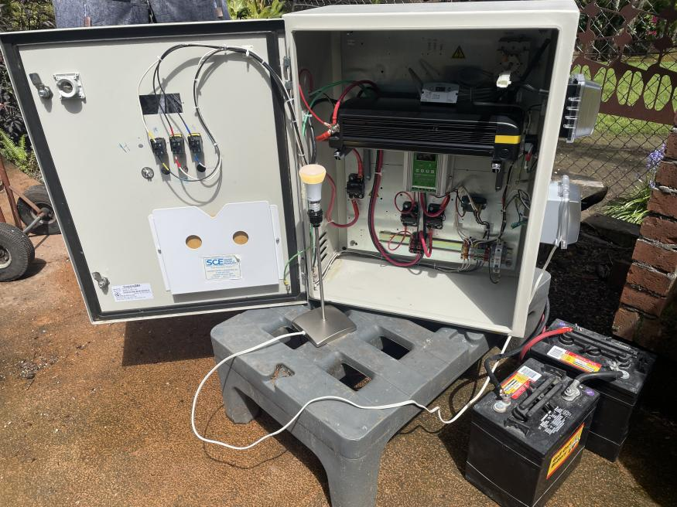
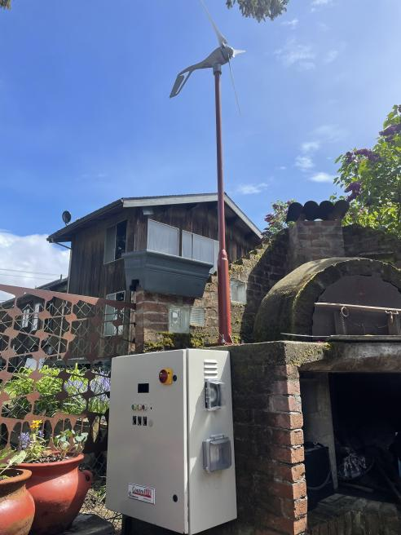

Small Scale Hybrid Microgrid System
Powering a pond pump with solar and wind
B.S. Renewable Energy Engineering
Rebecca Burfitt, Jacob Ewing
May 2022
Introduction
Design
Conclusions
Overview:
The koi fishpond at my coworker’s house requires constant water circulation and oxygenation which is provided by a ¼ horsepower pond pump
The goal of this project is to use renewable energy (wind and solar) to power the pond pump as often as possible
Project Site details:
A residential home in SW Portland with a pond
Our Motivation:
In our coursework, we have designed solar systems on paper, but we never got the chance to build them. With this project, we get to physically build and install the system for a client
Simplified Electrical Schematic
Simplified Component List
Components | Qty
400 Watt Wind Turbine | 1
200 Watt Solar Panel | 2
40 Amp MPPT Hybrid Charge Controller | 1
1800 Watt Inverter
6Volt, 200Ah Lead Acid Battery | 2
30 Amp Double Pole-Double Throw Relay | 1
150 Amp DC Fuse | 1
50 Amp DC Fuse | 1
25 Amp DC Fuse | 1
16 Amp AC Fuse | 1
Indicator Lights (red, yellow, green) | 3
Wires of various sizes (2 AWG to 16 AWG)
Key functions of the project:
Wind turbine and solar panels charge 12V battery bank
Power from the batteries (DC) is converted to AC power through the inverter. AC power is then consumed by the pond pump
Battery voltage is continuously monitored by the charge controller to avoid overcharging and over discharging
When the battery voltage drops to a pre-determined setpoint, the relay transfers the pump connection from the batteries to the house power automatically so the batteries can recharge
Once batteries are recharged, the relay will return the pump connection to the batteries
Final Outcome: the pump runs continuously without lags in operation. House power is only used as a backup when the batteries are not sufficiently charged by wind and solar
Results
Photo by Alejandro Aro on Unsplash
Objectives
Design and build an electrical system that powers a pond pump with wind and solar energy as often as possible
The electrical system should automatically switch to grid power when wind and solar energy are insufficient so that the pump is powered continuously
12 Volt battery storage system will be used
Acknowledgements
We would like to thank:
Energy350 for lending us a data logger and installing the device on our behalf
We would like to thank Zdenek Zumr for allowing us to construct and install this project at his house.
Our advisor: Dr. Robert Melendy
Video QR Code
Left Image: The fully constructed operational system powering a lightbulb
Scan the QR Code to watch a video of our project in action!
Right Image: The electrical system is weatherized and is mounted on the front patio of the house.

