Slide 1



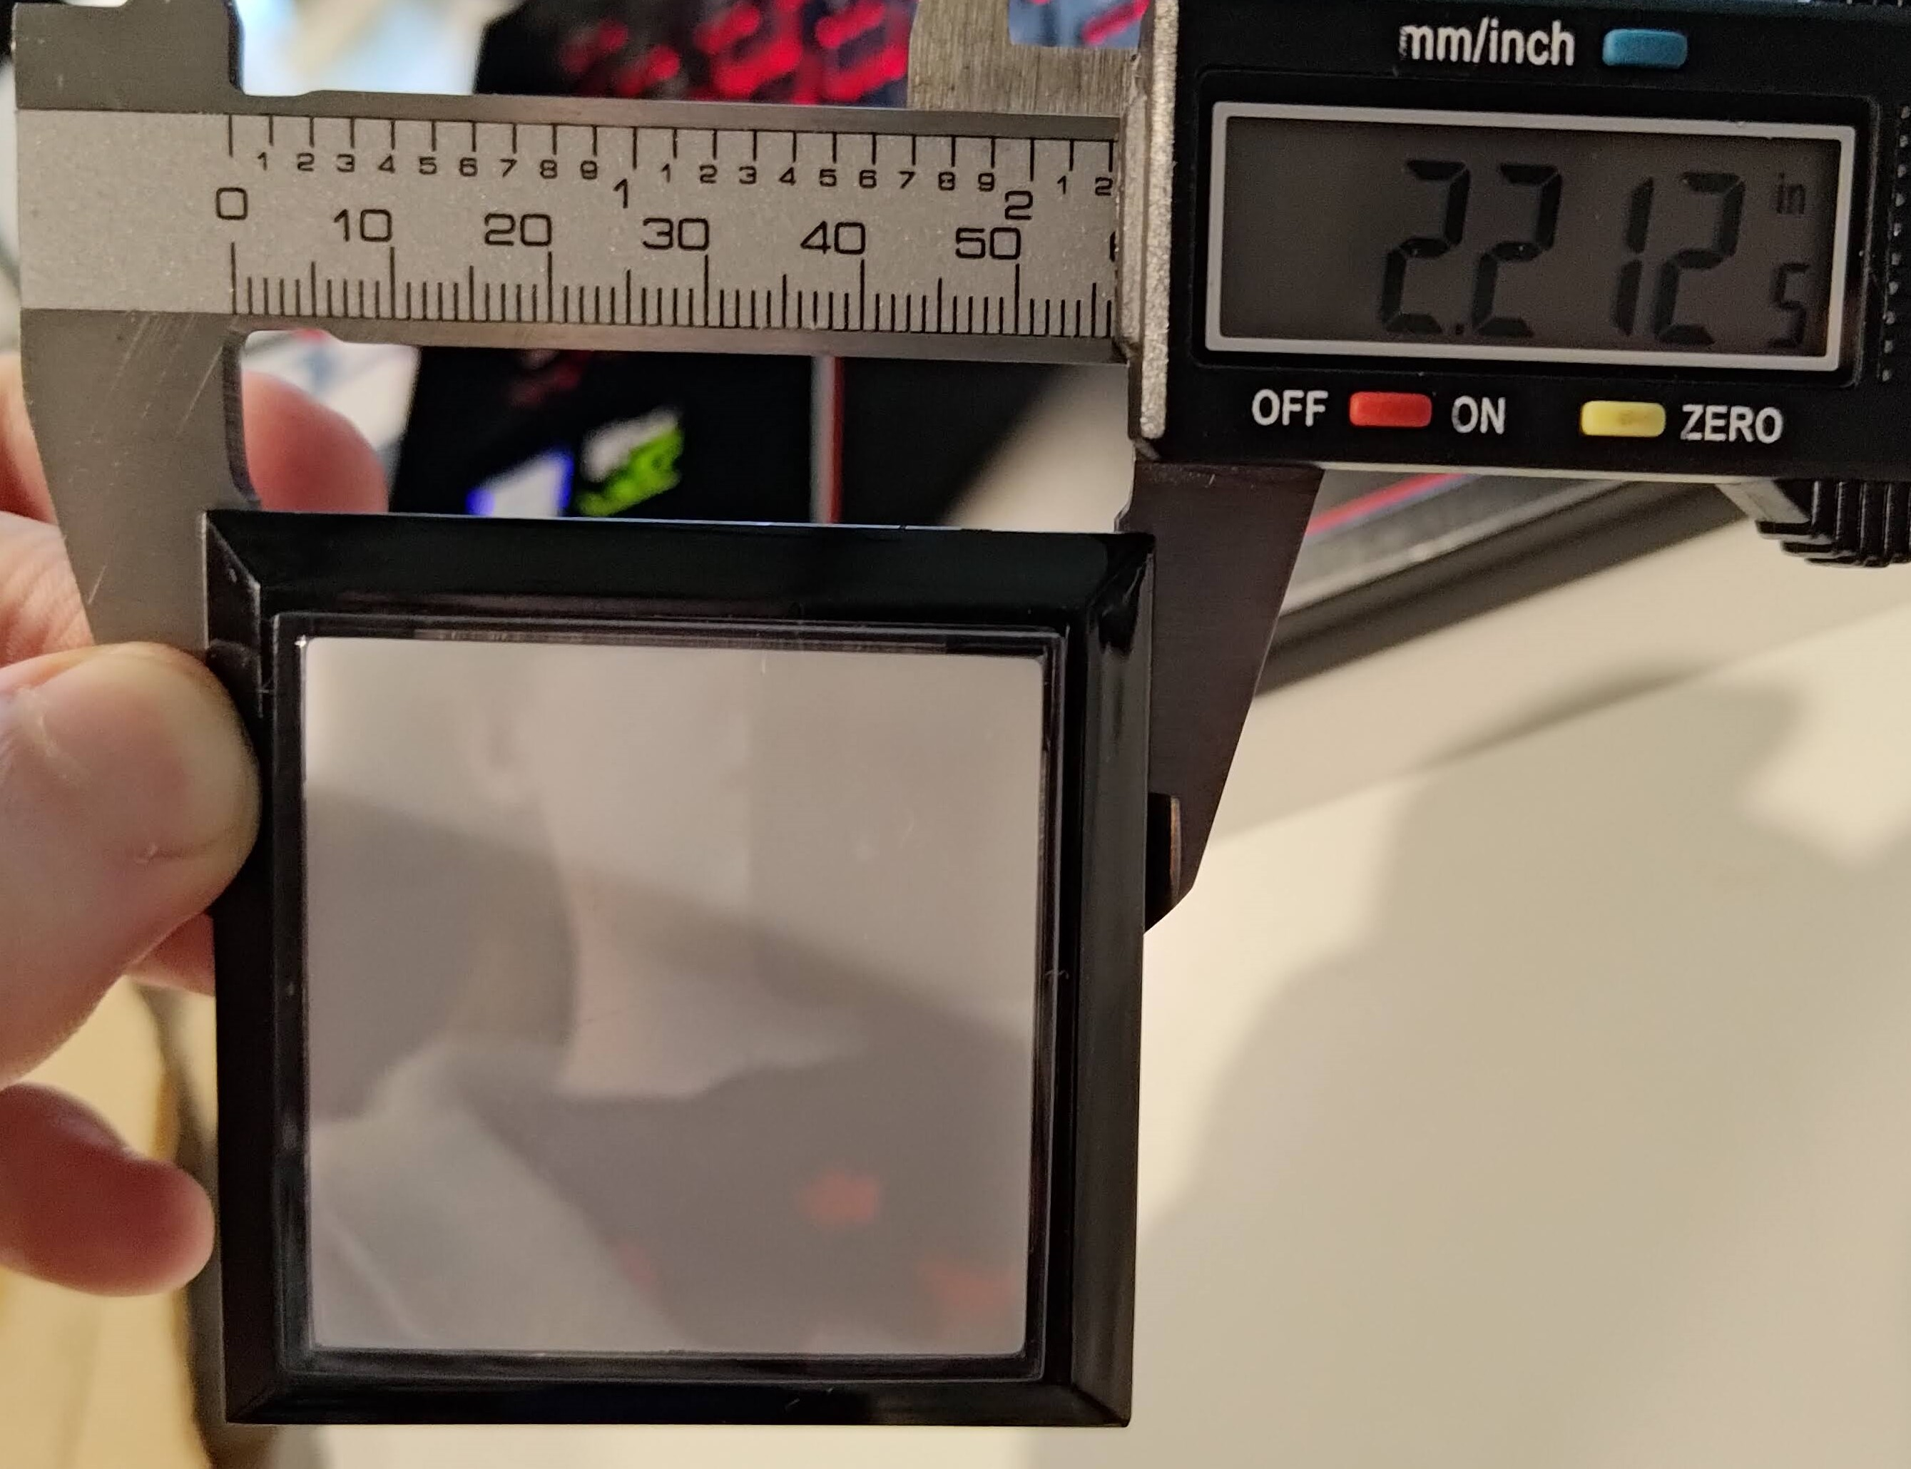
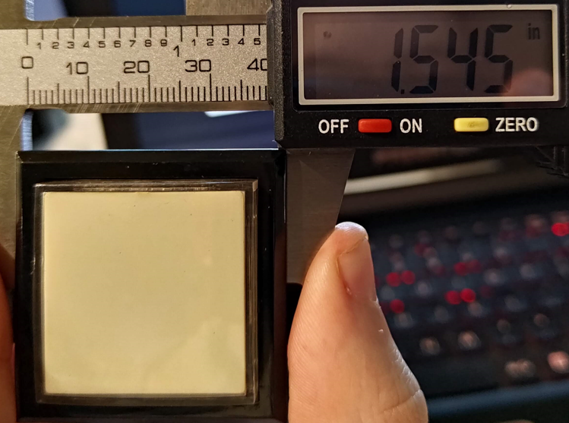
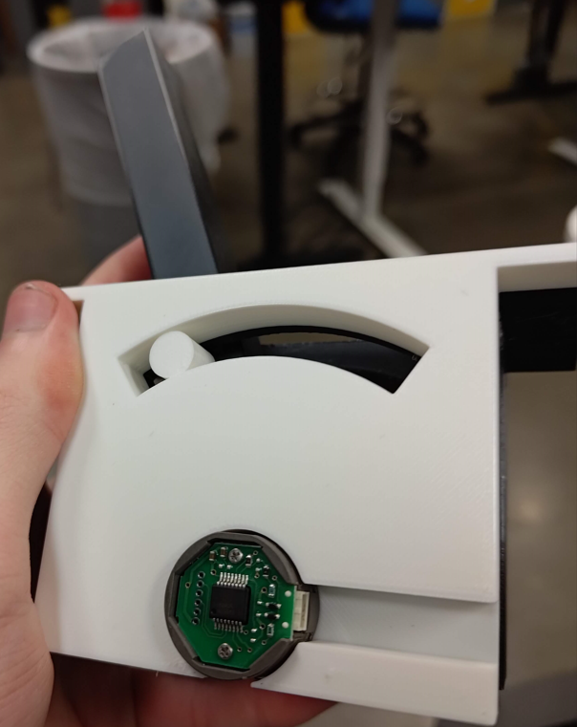
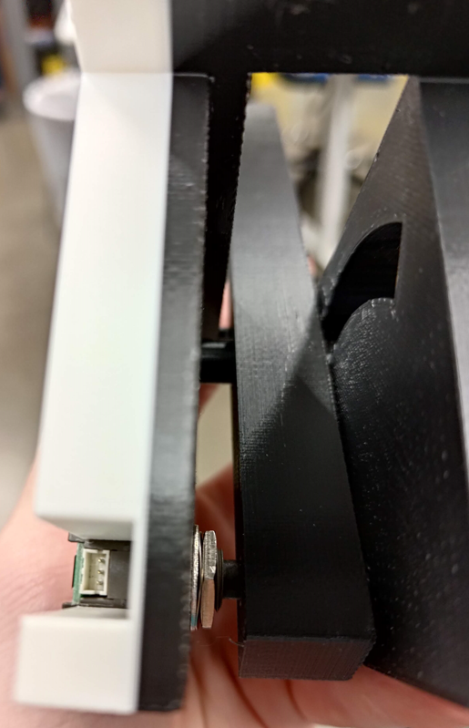
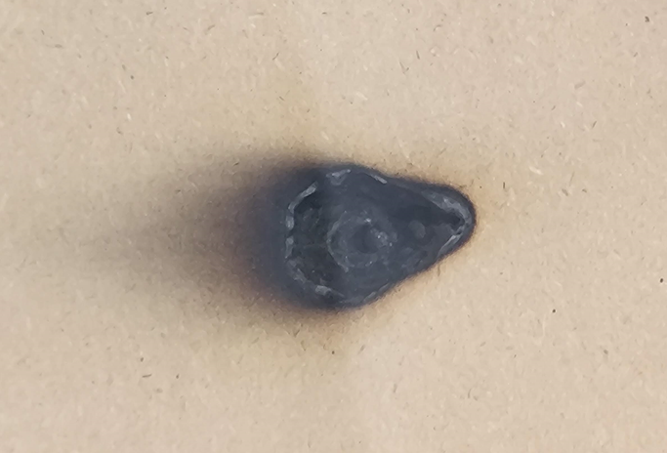
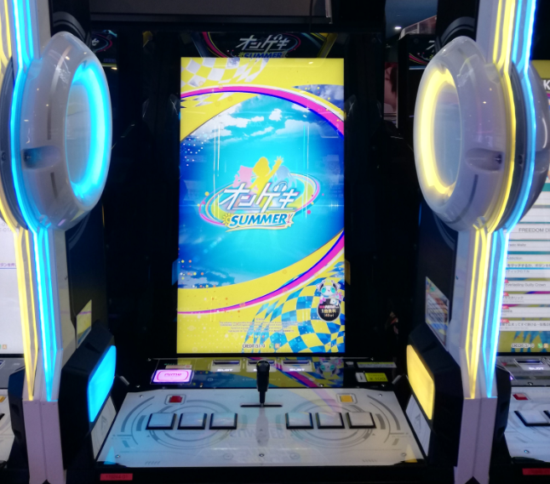
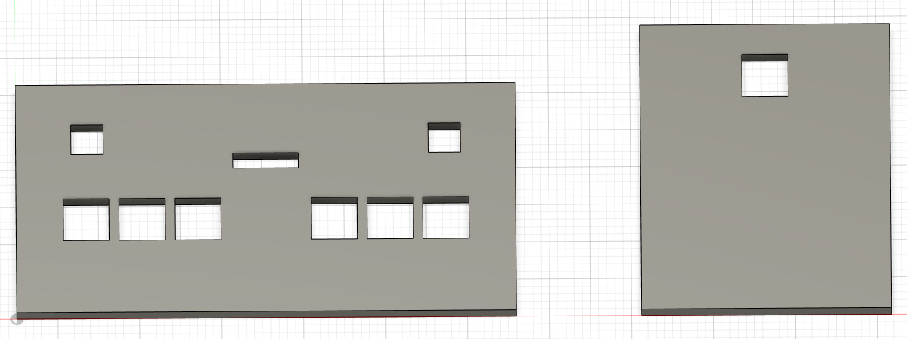
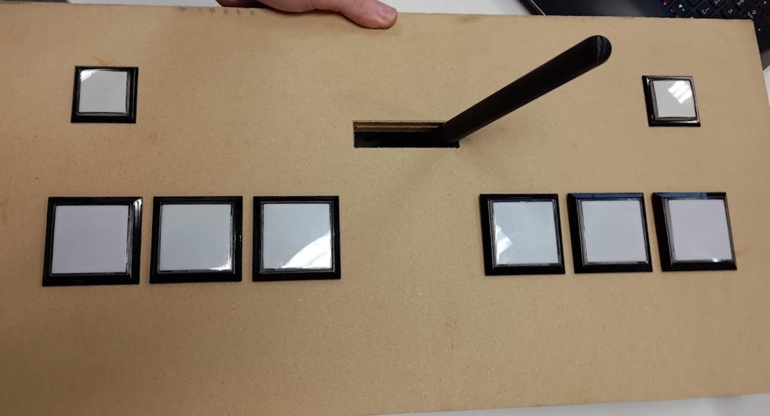
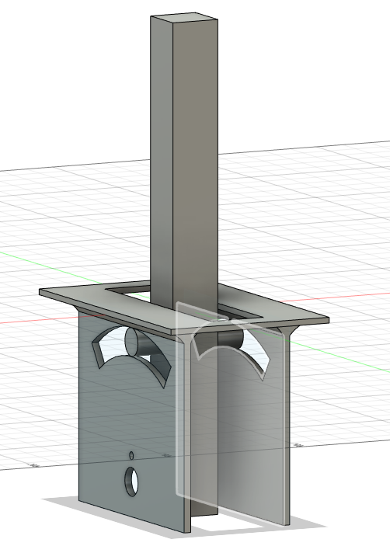
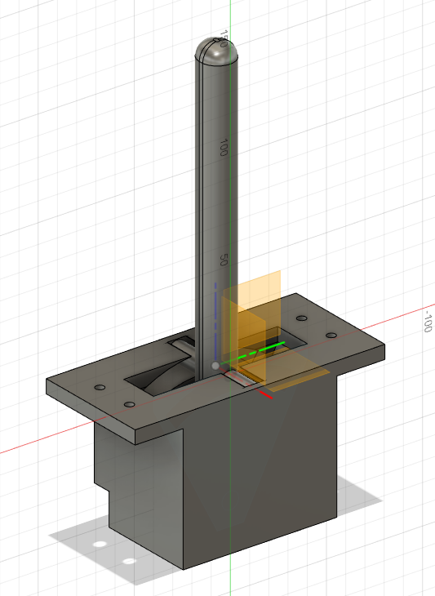

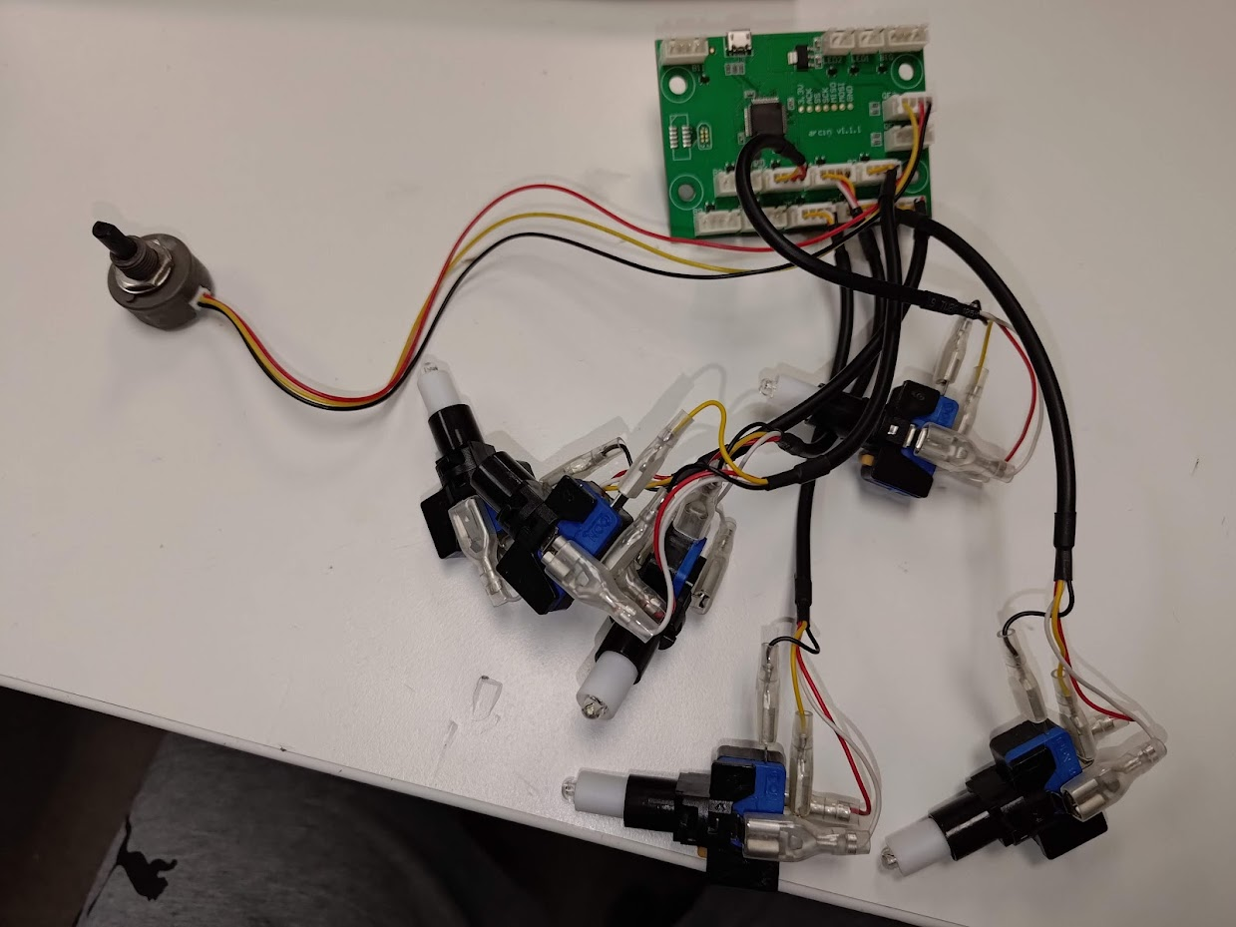
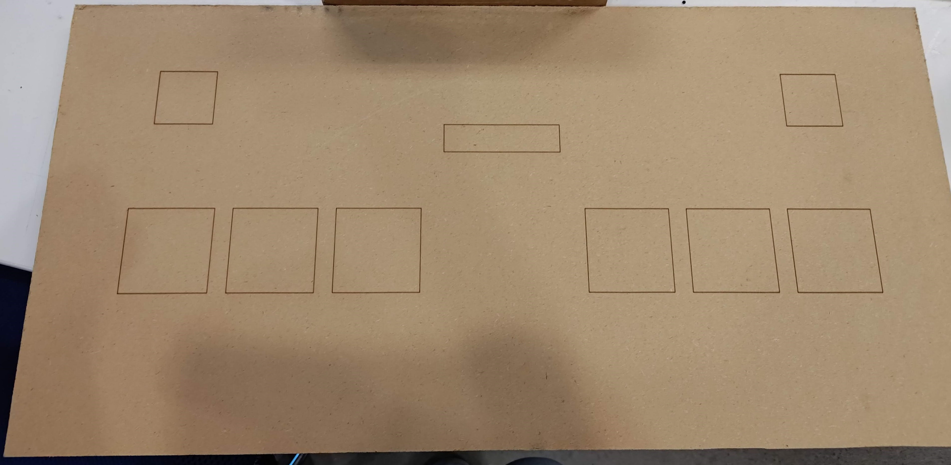

O.N.G.E.K.I. Controller
Embedded Systems Engineering
Michael Cluff
LinkedIn:
May 2023
Introduction
Method
Results
Conclusions
ONGEKI is a Japanese arcade rhythm game that is not available in any major arcade in the US. There is also not a single seller of controllers for this game.
Fig. 10. Don’t try to laser cut MDF…
Fig. 2. Measure parts
Building a controller from scratch can be a challenge but is fully possible
3D printing is a great tool for designing and prototyping non-standard parts (like a lever)
Interfacing a controller with an arcade game can be a challenge
Fig. 6-7. First prototype lever. It worked but I redesigned it to be better later.
Fig 1: Real ONGEKI cab
Fig. 3. Design top and side pieces of controller
Objectives
Additional Information/Next Steps
The main objectives of my project is:
  Build a controller for ONGEKI
  Make the controller fully functional in the game
  Make all files and schematics for the controller available for anyone to download so they can build it themselves
Designs and schematics for my project will be posted on my GitHub at a later date once I ensure everything is finalized and working.
Fig. 8. Top of controller with buttons and lever in place
Github:
@Goatgarien
Fig. 4. Initial and final designs for the lever
References
All measurements were made using a friend’s cabinet in Seattle
Acknowledgements
I would like to thank the following people:
  Phong N.
  Felix
  Anthony K.
  The Rapid Prototyping Lab
Fig. 5. Design laser cut into wood before cutting it
Fig. 9. Switches and Encoder connected to my main PCB (Arcin)

