Slide 1



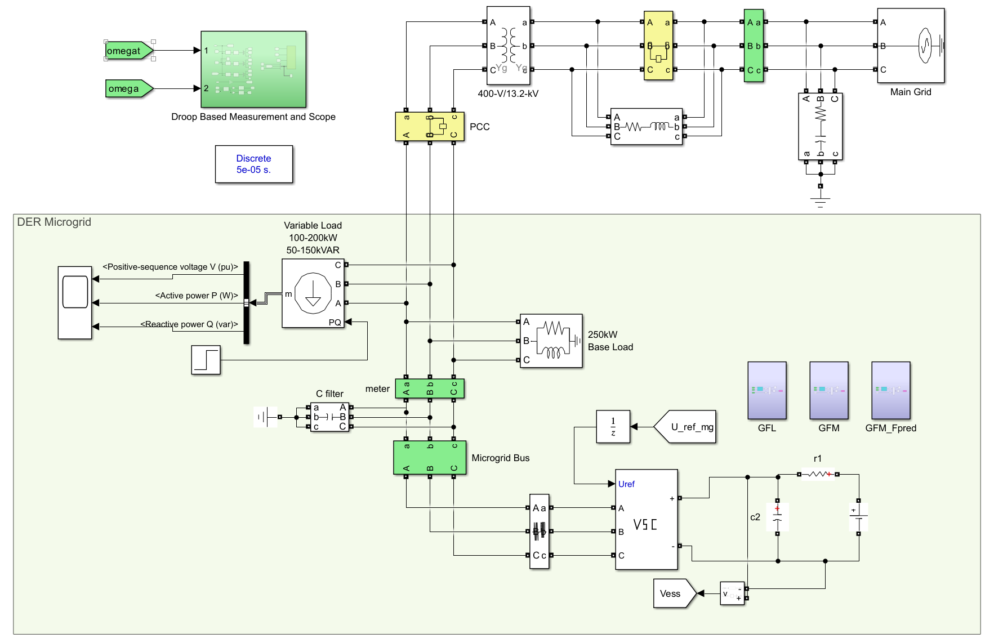
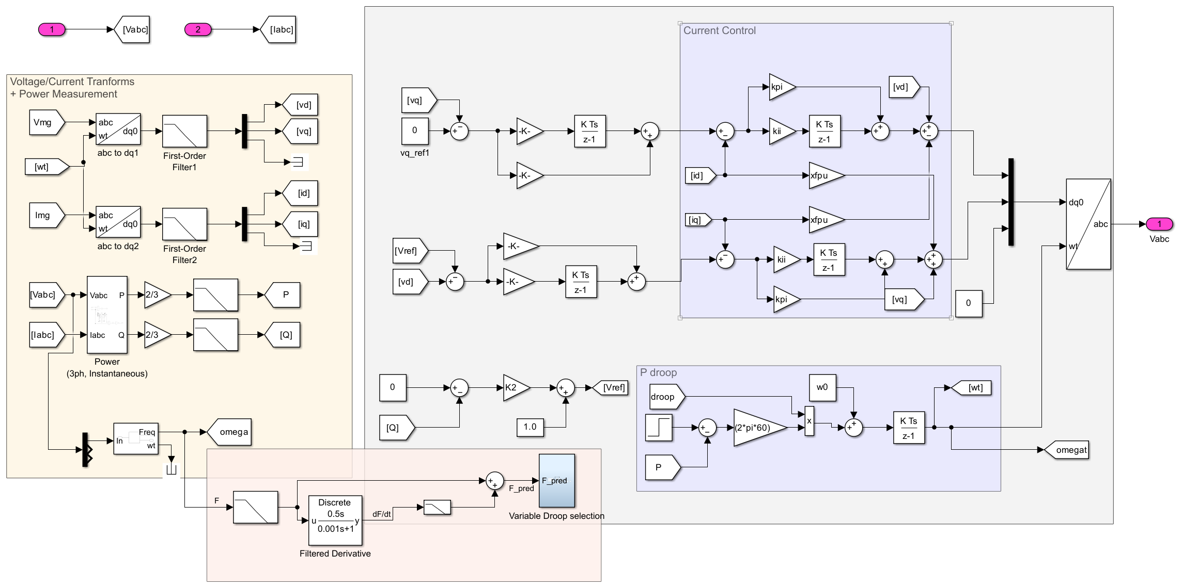
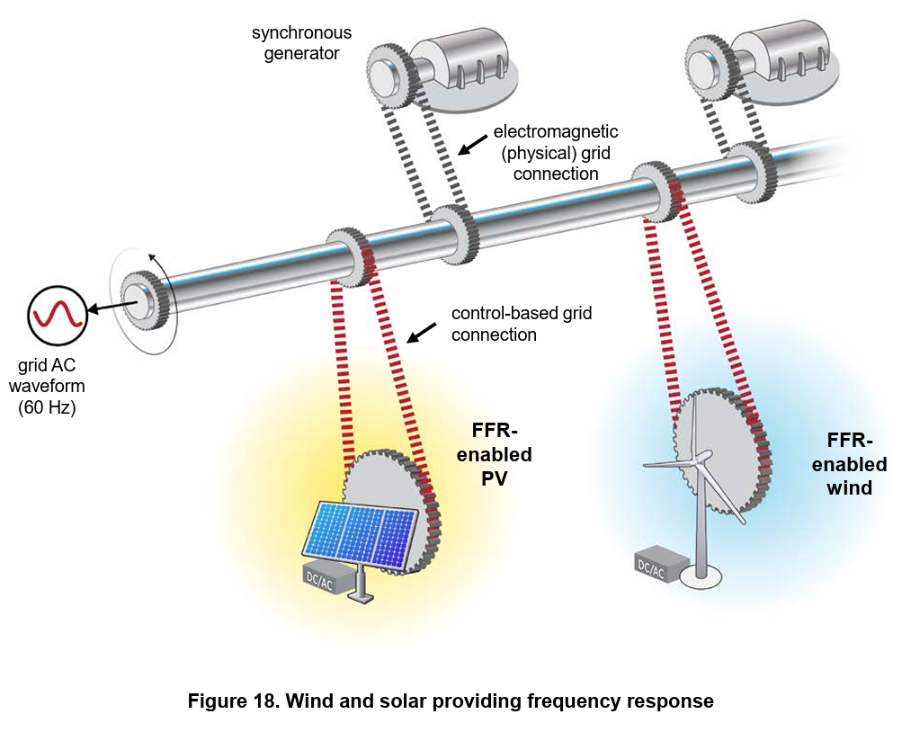
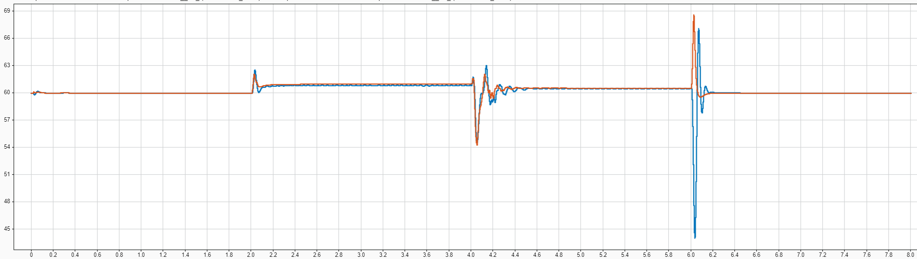
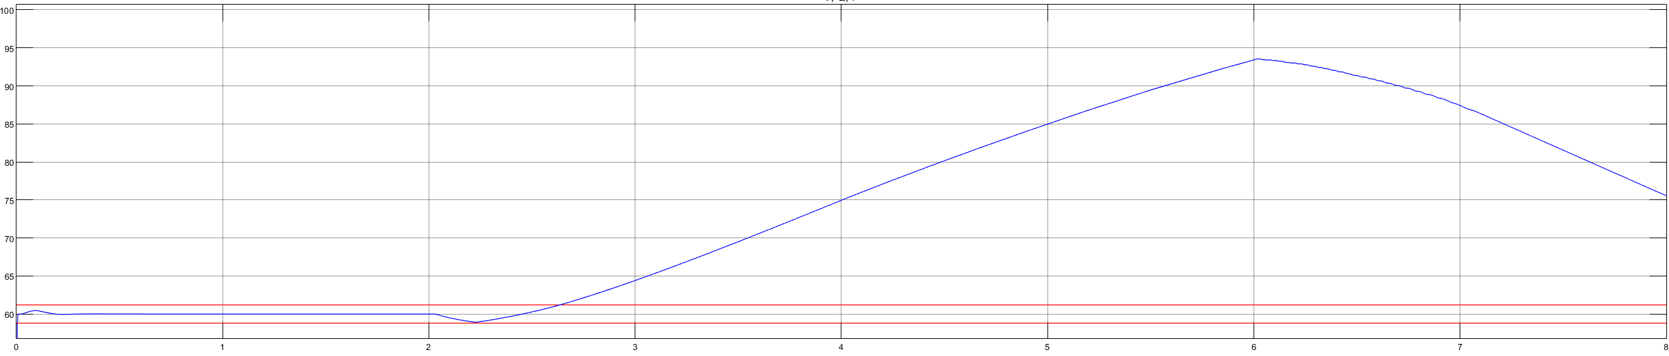
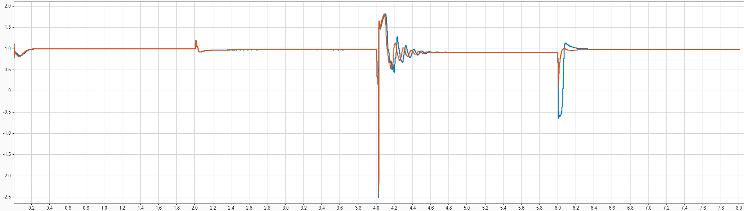
Virtual Inertia for Frequency Stability: microgrids with zero spinning generation
Electrical Engineering and Renewable Energy
Jesse Lutterloh
LinkedIn
June 2025
Introduction
Method
Conclusions
As the transition to a fully renewable, clean energy grid continues, more inverter-based resources are deployed, replacing spinning generation and reducing overall system inertia. This project looks at the most common methods of virtual inertia implementation using MATLAB/Simulink, and attempts to improve on one that appears most promising for microgrids.
What was learned from the process:
Grid-following inverter requires external AC source for reference, does not work for islanded system with only IBRs
Power system with zero spinning generation requires grid-forming inverter
Transform from abc to dq0 reference frame greatly reduces control complexity, but can limit system fidelity
It is important not to be locked into one method or another for system modeling (can waste a lot of time by not exploring many options)
For a converter to produce adequate AC output from a DC source, the DC voltage must be significantly higher than the desired AC amplitude
What was learned from the results:
Droop control seems to be the simplest method with the most desirable results for virtual inertia implementation
The frequency signal is too noisy to use for direct control of the droop function, using the real power has much smoother result
the modified method had to be converted from a frequency-predictive control to variable droop control
Proper tuning of the control loop gains is crucial to system stability (in some instances gain adjustments of <5% destabilized the system)
Modern grid-forming inverters do an adequate job of providing virtual inertia, what remains is to develop and publish standards for such systems
Figure 2: Simulink power system – islandable microgrid with BESS connected via grid-forming inverter. Selectable inverter control methods
Figure 3: Control subsystem - abc to dq0 transform, PI control of currents, frequency droop control with variable droop characteristic (based on [2])
Results
Figure 1: Visualization of inertia in a power system [1]
Simulation events: 0-2s: grid connected | 2s: planned island | 2-4s islanded, 50% rated power | 4-6s: load increase, 100% rated power | 6-8s: reconnect to grid
What is inertia, and why does it matter?
Inertia is how rapidly a system’s “speed” changes as a result of a change in the net force on that system
In AC power systems “speed” is the electrical frequency
Traditional generators have physical inertia in the mass of their rotors = high inertia
Most renewables have no physically moving mass = low inertia
Low inertia = rapid frequency changes = unstable
Figure 4: Comparison of frequency for the original grid-forming inverter and the version modified for this project
Longest exit from continuous operating range: original = 67ms | modified = 44ms
Maximum deviation: original = 7.4Hz | modified = 14.8Hz
Frequency-droop control
Modified Frequency-droop control
Additional Information/Next Steps
Objectives
Recommended next steps:
Increase system complexity – utilize multiple inverters with different operating modes (this project was limited by the student license of MATLAB, exceeded block limits)
Hardware model of system – limited documentation for such an implementation will be available from this project archive by Fall 2025
Understand minimum requirements to implement virtual inertia
Compare most common methods in current literature
Improve upon at least one method for use in 100% renewable energy microgrids
Increase response time and/or reduce severity of transients
Grid-following mode
Figure 5: Frequency of grid-following inverter model (traditional inverter model). Performs well will grid-connected, but loses synchronization and fails to stabilize in island mode
Acknowledgements
Figure 6: Comparison of voltage for the original and modified grid-forming methods. Though the goal of the project was not to improve voltage stability, it is still important to ensure that it stays within safe operating standards, as outlined in IEEE 1547
References
Dr. Eklas Hossain and Toby Farkas:
- for guiding my research in the proper direction
Oregon Tech EERE department:
- for providing world class education the many years I attended
My family
- for their unwavering support, without which I could not have gotten here
[1] Denholm, Paul, et al. Inertia and the Power Grid: A Guide without the Spin, 1 May 2020, https://doi.org/10.2172/1659820.
[2] Fan, Lingling, and Zhixin Miao. “Chapter 6: Grid-Forming (GFM) Control.” Modeling and Stability Analysis of Inverter-Based Resources, 1st ed., CRC Press, Baco Raton, FL, 2024.
Frequency-droop control
Modified Frequency-droop control

